Slide 1
MTRN2060 System Response II Second order systems

Slide 2
What is System Response?
A typical simple system has one input and one output.
Examples (input: output)
Amplifiers from last week (input Voltage: output Voltage)
A to D converter (input voltage: 10 bit digital level)
DC motor (input Voltage: motor speed, or motor position)
DC motor (load torque: motor speed)
Vehicle suspension (road surface: vehicle height)
Electric guitar pickup (string vibration: electrical signal)
Vehicle steering (steering wheel angle: tire angle, direction of vehicle travel)
Vehicle throttle (gas pedal position: air valve position, motor torque, speed, power, …)
In nearly all cases we can describe the system response by asking two questions:
How does it respond to a step change in input?
How does it respond to an oscillating input of different frequencies?

Slide 3
To answer that we can perform experiments, and/or model the system and predict response
Many mechatronic systems can be modeled as linear ordinary differential equations
Many are generally non-linear, but linear over a limited range.
Consider the order of a system
A zero order system has gain or sensitivity. No time delay or distortion Out = Gain x In
The voltage at some point in a circuit containing DC sources and resistors can be written as an equation with no time dependence.
Can you describe a zero-order mechanical system?
A first order system has time delay, typically described by a single exponential
A second order system has time delay, and is capable of oscillation in response to a non-oscillating input. It has a restoring force and a damping force.
Notes:
No mechanical system can be zero order unless it has no mass. Mass takes time to accelerate.

Slide 4
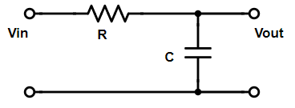
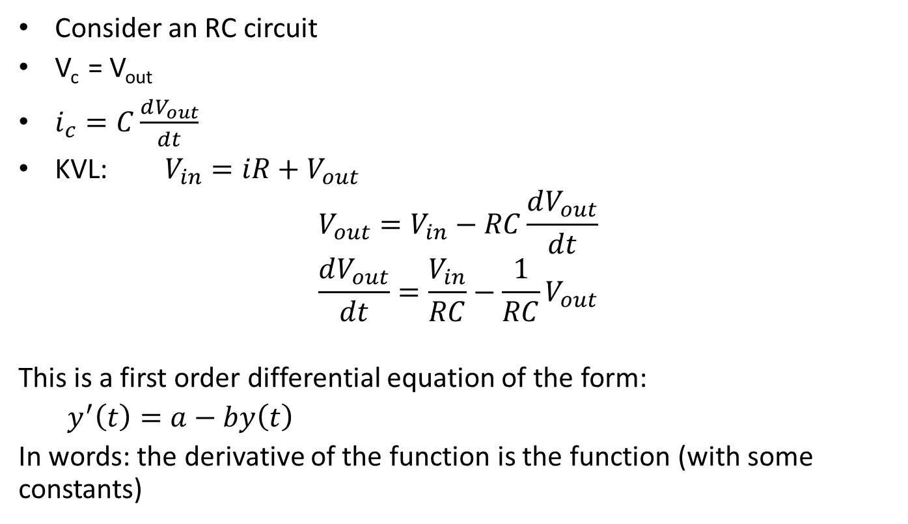
First Order System
Consider an RC circuit
V_{c} = V_{out}
$i_{c}=C\frac{dV_{out}}{dt}$
KVL: $V_{in}=iR+V_{out}$
$$V_{out}=V_{in}−RC\frac{dV_{out}}{dt}$$
$$\frac{dV_{out}}{dt}=\frac{V_{in}}{RC}−\frac{1}{RC}V_{out}$$
This is a first order differential equation of the form:
$y^{′}\left(t\right)=a−by\left(t\right)$
In words: the derivative of the function is the function (with some constants)
Notes:
Draw low pass filter and derive transfer function
Linear fit to the log to determine if it is first order.

Slide 5
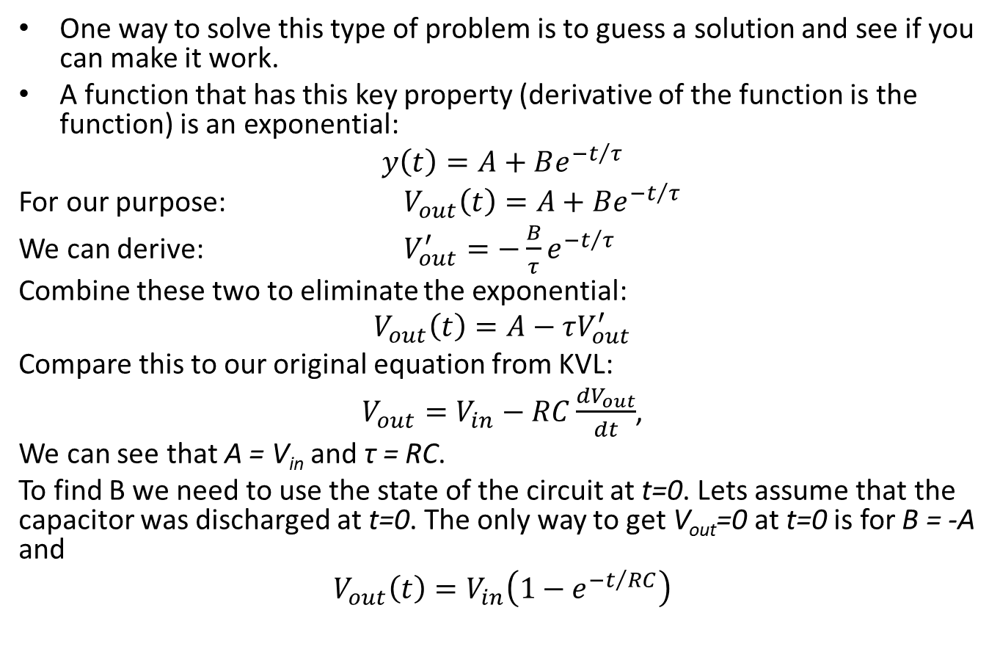
First Order System, cont.
One way to solve this type of problem is to guess a solution and see if you can make it work.
A function that has this key property (derivative of the function is the function) is an exponential:
$$y\left(t\right)=A+Be^{{−t}/τ}$$
For our purpose: $V_{out}\left(t\right)=A+Be^{{−t}/τ}$
We can derive: $V_{out}^{′}=−\frac{B}{τ}e^{{−t}/τ}$
Combine these two to eliminate the exponential:
$$V_{out}\left(t\right)=A−τV_{out}^{′}$$
Compare this to our original equation from KVL:
$V_{out}=V_{in}−RC\frac{dV_{out}}{dt}$,
We can see that A = V_{in} and τ = RC.
To find B we need to use the state of the circuit at t=0. Lets assume that the capacitor was discharged at t=0. The only way to get V_{out}=0 at t=0 is for B = -A and
$$V_{out}\left(t\right)=V_{in}\left(1−e^{{−t}/{RC}}\right)$$

Slide 6
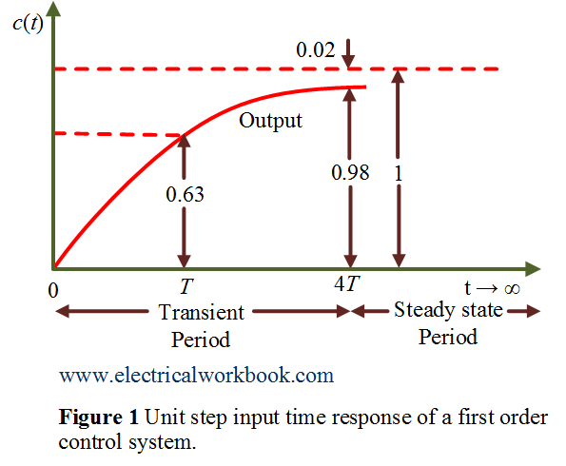
All first order systems have a time constant (τ) and respond to a step function with a single exponential decay or rise.
Time constants describe the characteristic speed of a response. 63% of steady state after 1τ. 98% of steady state after 4τ
Observing the step response of a system is usually much easier than modelling the system and solving equations, but can give similar information.

Slide 7
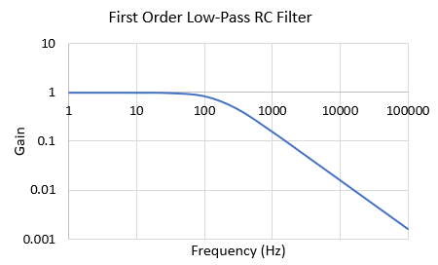
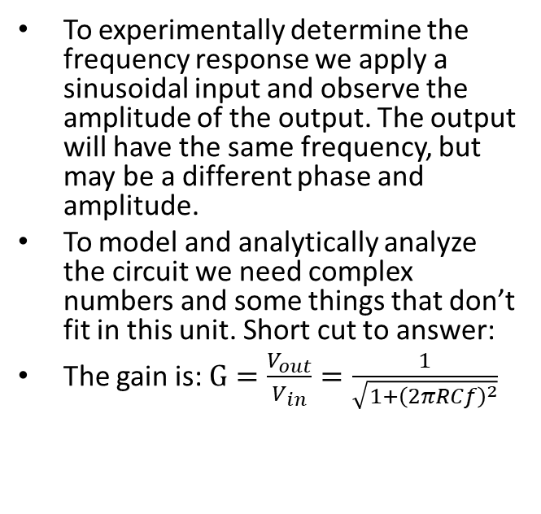
Let’s consider the frequency response of this system
To experimentally determine the frequency response we apply a sinusoidal input and observe the amplitude of the output. The output will have the same frequency, but may be a different phase and amplitude.
To model and analytically analyze the circuit we need complex numbers and some things that don’t fit in this unit. Short cut to answer:
The gain is: $G=\frac{V_{out}}{V_{in}}=\frac{1}{\sqrt{1+{\left(2πRCf\right)}^{2}}}$
For typical values of 1 kΩ and 1 uF, RC=0.001 s. Graph shown.
We could experimentally get this.
We would see that sine or cosines with a frequency less than 1000 Hz pass right through the system, but higher frequency do not pass through.
Next we will look at the step response and frequency response of second order systems
Notes:
This is an example of a Bode plot. You will see more of these in 2070 and 2040.

Slide 8
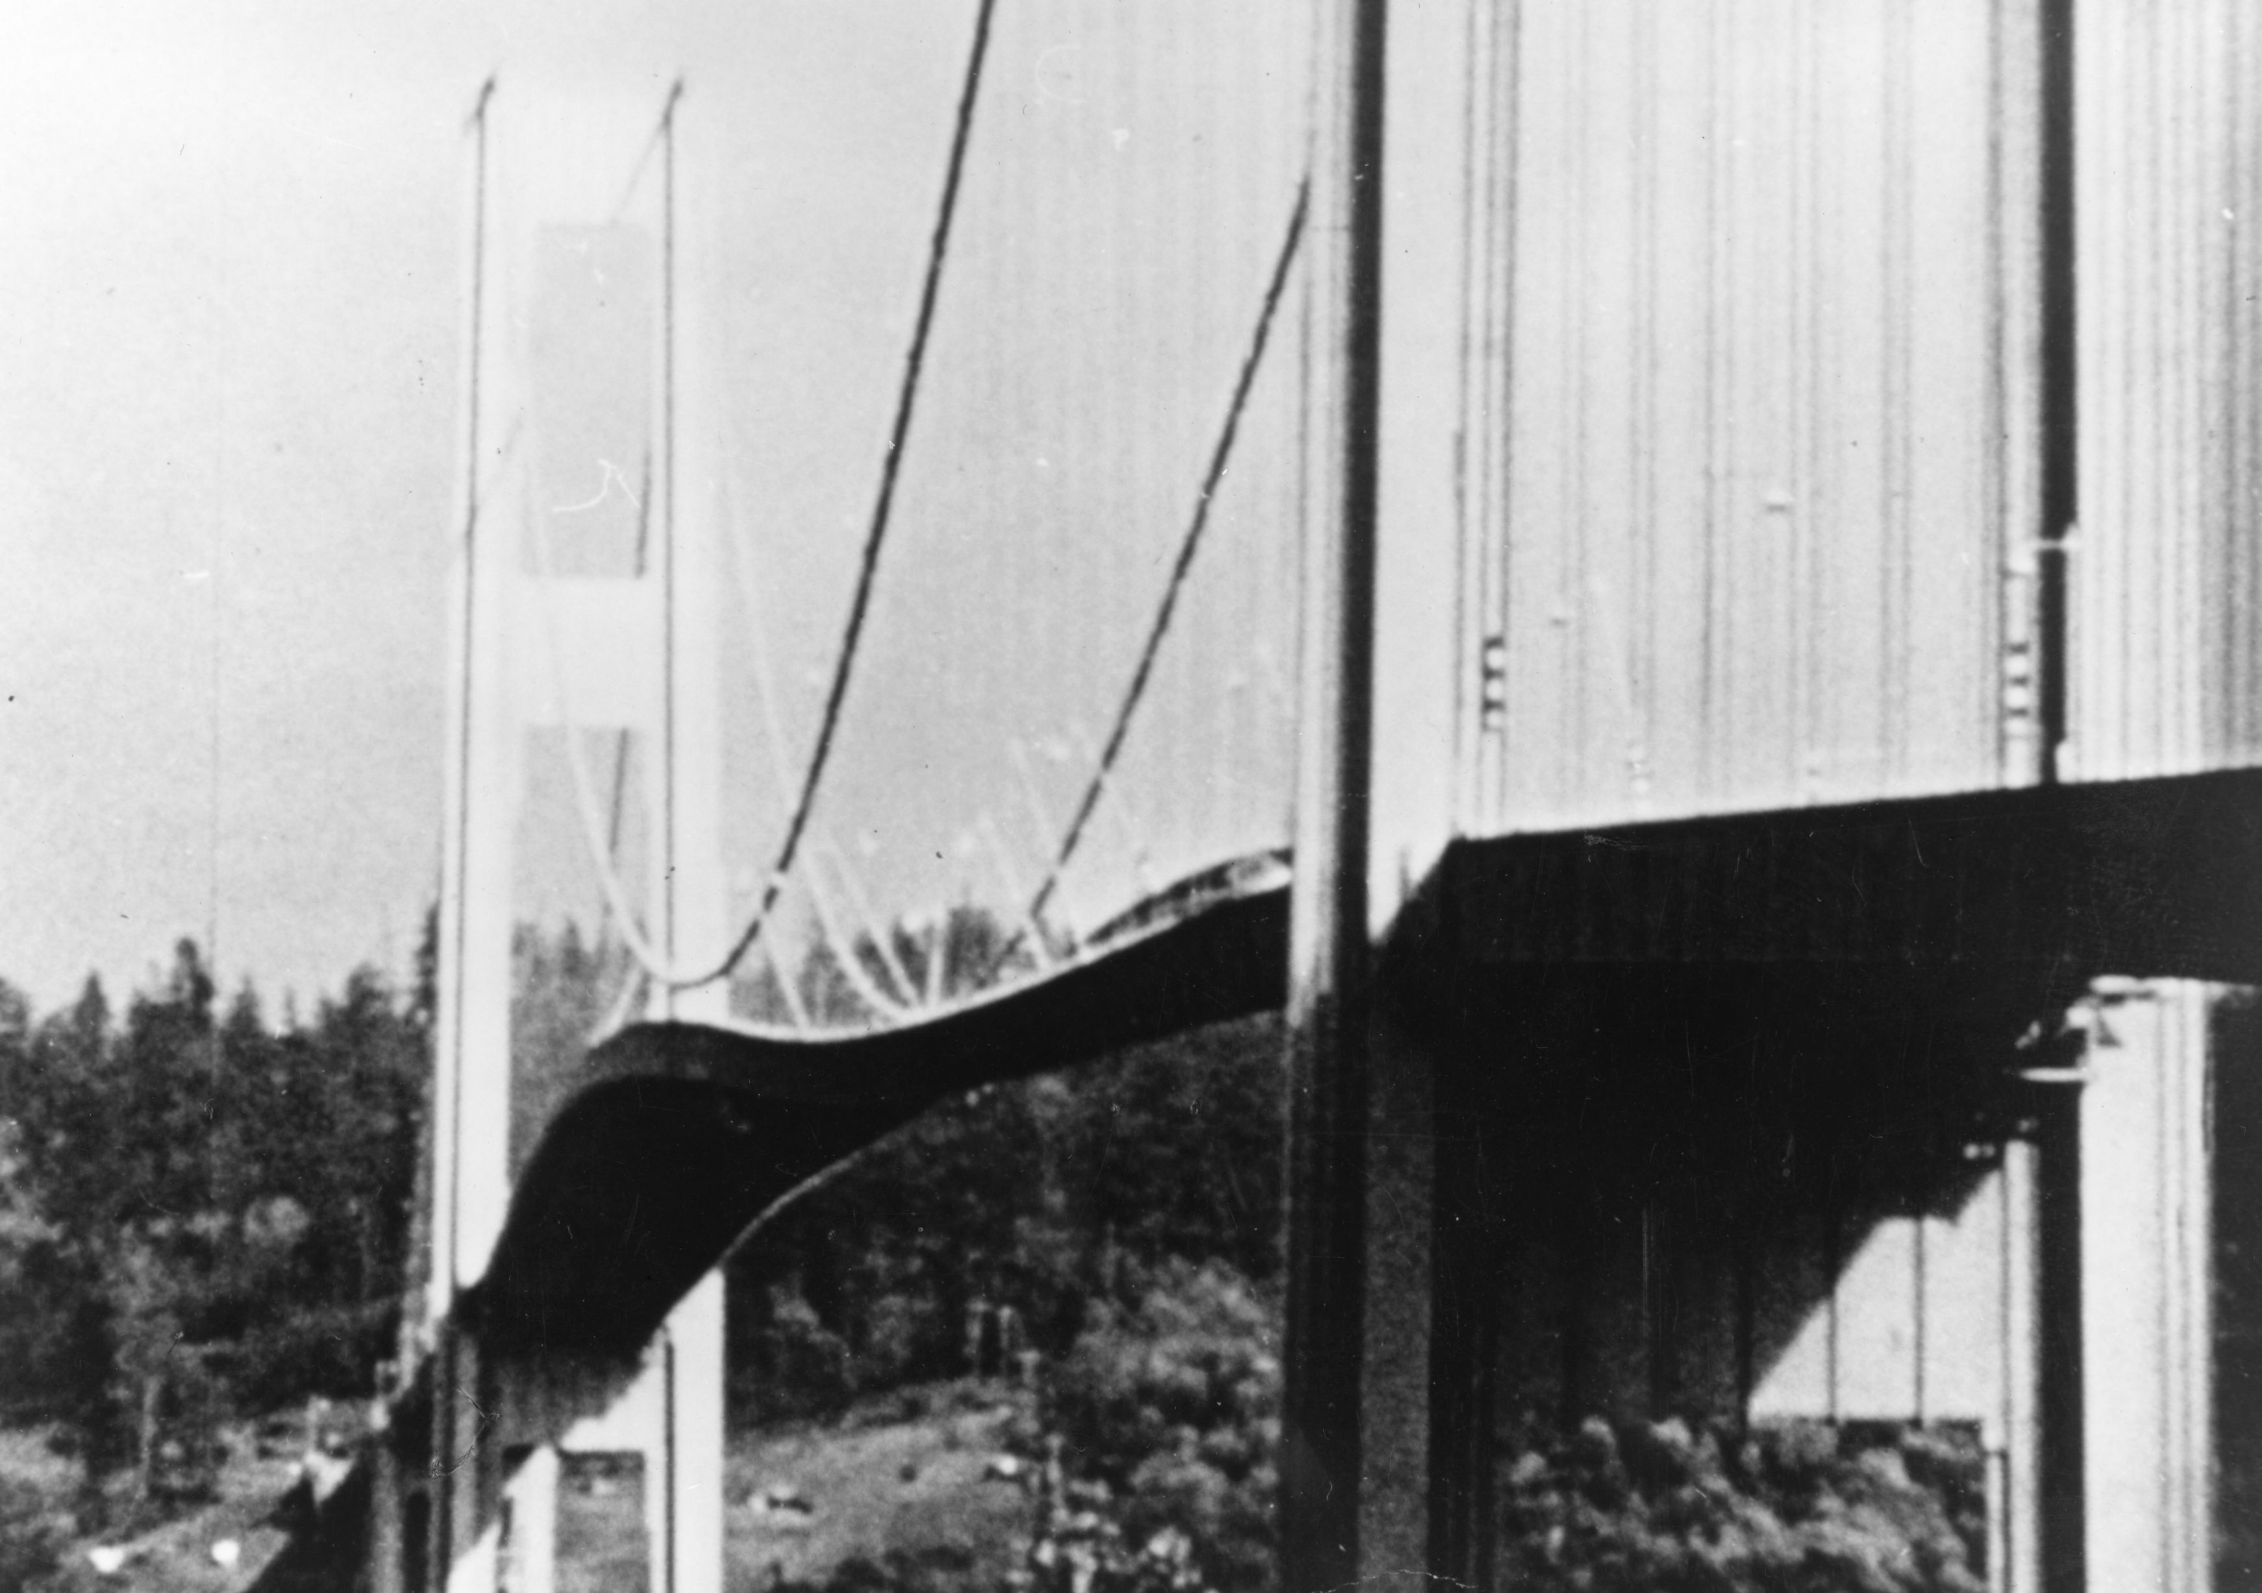
Second Order Systems
Second order systems are ubiquitous and all engineers must understand the basics. They are called 2nd order because they contain a second derivative
Many systems can be simplified to an ordinary linear 2nd order differential equation such as the spring-mass-damper.
Which is characterized by damping ratio ζ and resonant or natural frequencey ω_{n}.
Gravity, mass and friction are all that is required.
Consequences of not grasping these ideas: Tacoma Narrows bridge resonaces driven by wind

Slide 9
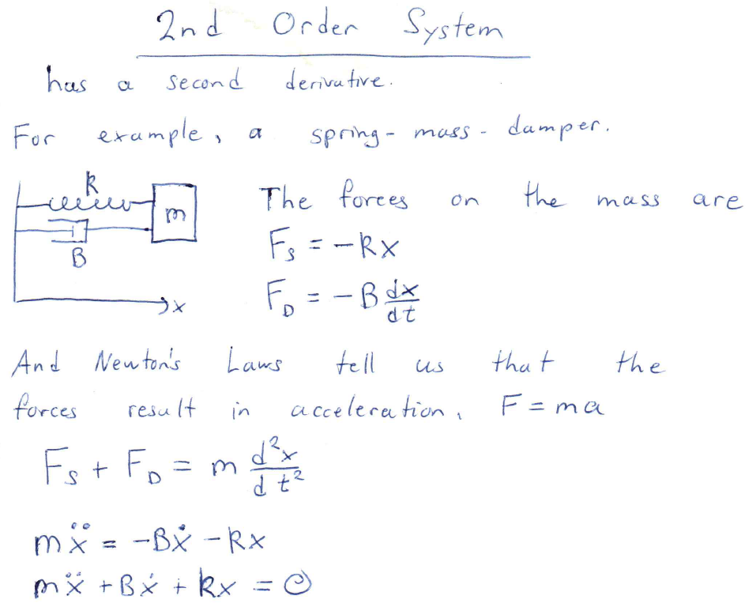
Consider the classic Mass-Spring-Damper We can find nice solution in some cases. For the full solution to the damped oscillator, see the text book.
Notes:
Derive differential equation.
Show solution with no damping to define resonant or natural frequency
Derive critical damping
Define Damping Ratio

Slide 10
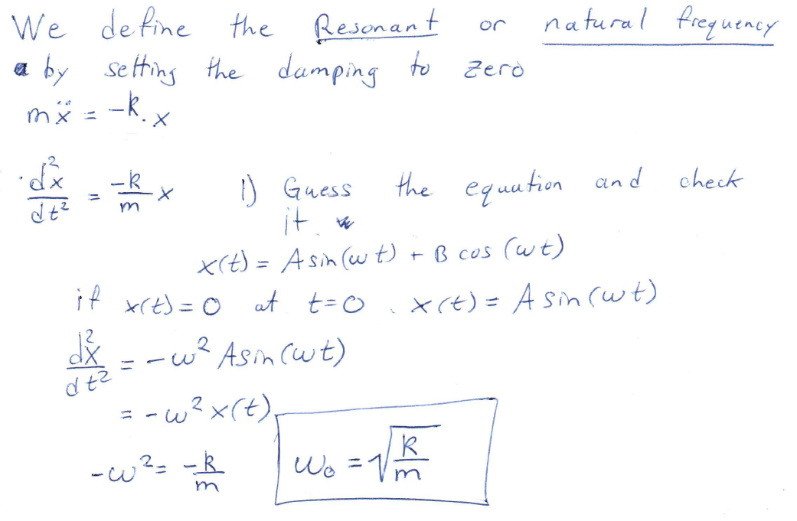
This formula is really fundamental. It says that the natural vibration frequency is given by the square root of the ratio of the restoring force to the mass. You find the same for in equations for the speed of sound and the frequency of a pendulum

Slide 11
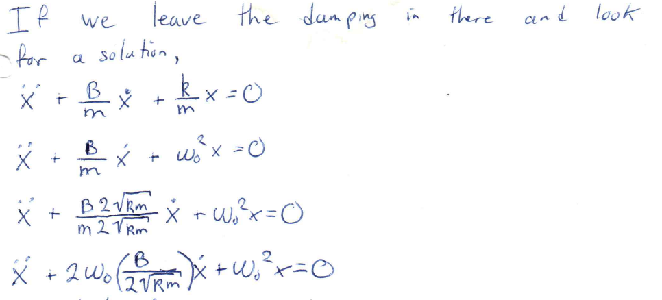
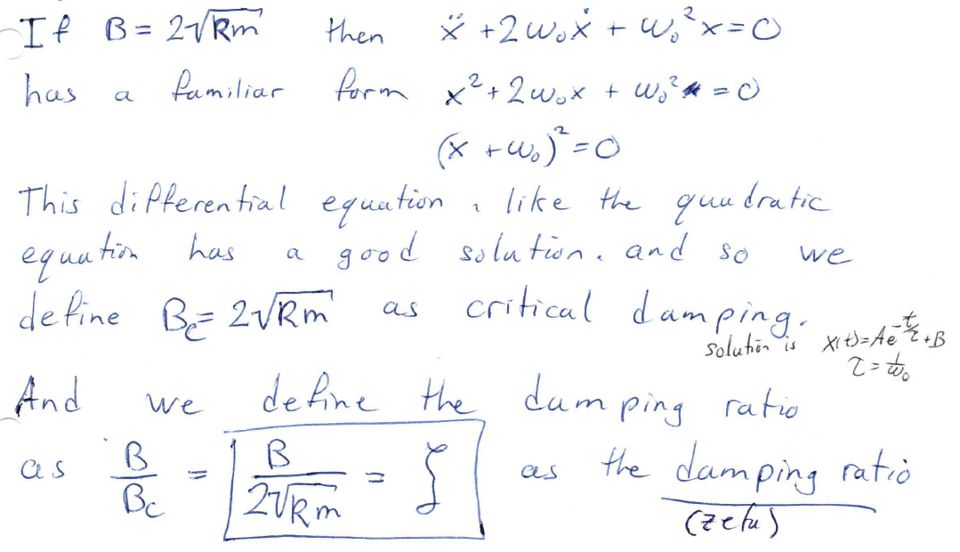
This substitution is a special condition. You will see the significance later

Slide 12
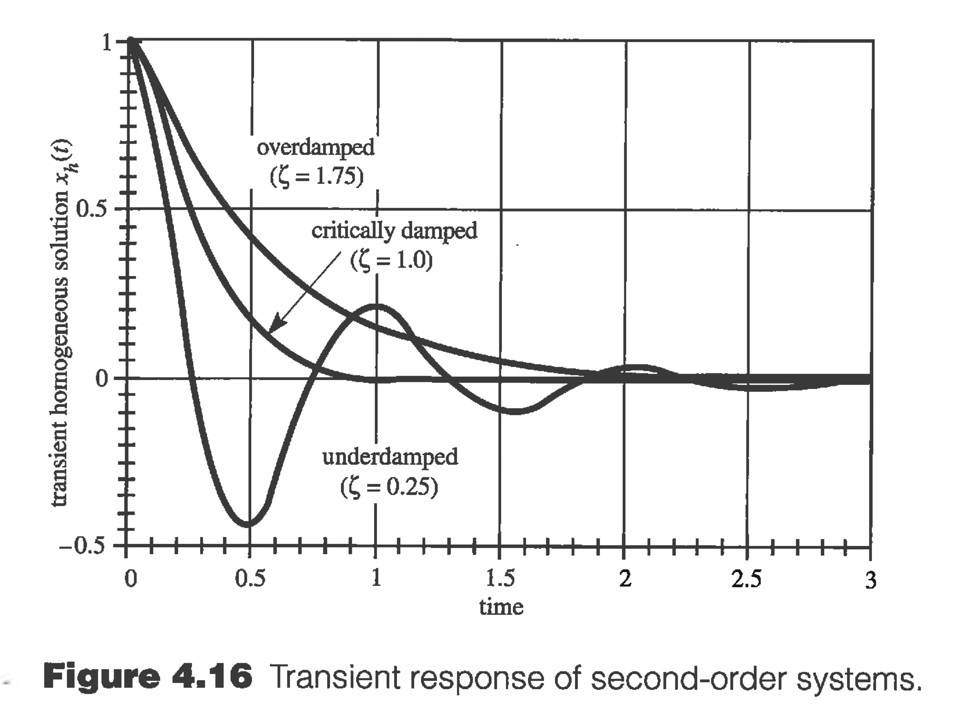
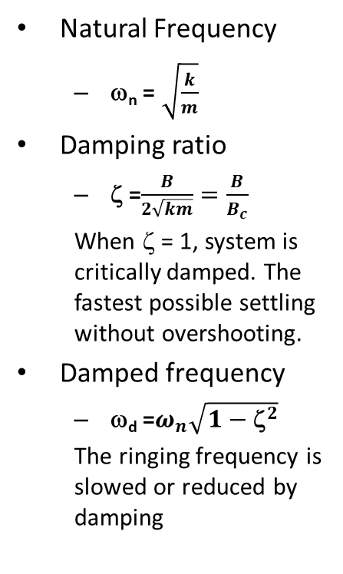
Transient or Step Response of 2nd Order System
The damping ratio (zeta) is a measure of how close the damping is to that special condition from the previous slide.
Natural Frequency
ω_{n} = $\sqrt{\frac{k}{m}}$
Damping ratio
ζ =$\frac{B}{2\sqrt{km}}=\frac{B}{B_{c}}$
When ζ = 1, system is critically damped. The fastest possible settling without overshooting.
Damped frequency
ω_{d} =$ω_{n}\sqrt{1−{\text{z}}^{2}}$
The ringing frequency is slowed or reduced by damping
ζ = 0.7071 is called ideally damped and gives the fastest settling time with overshoot
Notes:
The formulas on this page are really important and should be noted down in a formula sheet.
Understand the difference between ideal and critical damping.

Slide 13
Frequency Response of a System
To determine the frequency response of a linear system, we apply sinusoidal inputs and measure the output amplitude.
After a short period a transience, a constant sinusoidal output will result. The output will have a different phase and amplitude from the input, but the same frequency.
Plotting this resulting amplitude and phase versus frequency gives Bode Plots. These Bode Plots (log/log) for amplitude give important information.
They can be mathematically determined from the differential equations using Laplace transforms.
This gives the “Transfer Function” which gives the output amplitude versus frequency
Combining this with our understand of Fourier series allows us to see how any time varying signal will be measured, affected, or amplified by a system.
We will not solve these problems here, but you must know the characteristics of a first and second order system

Slide 14
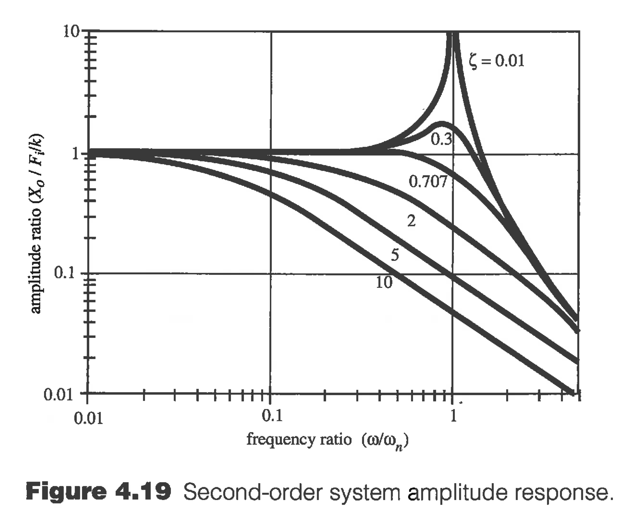
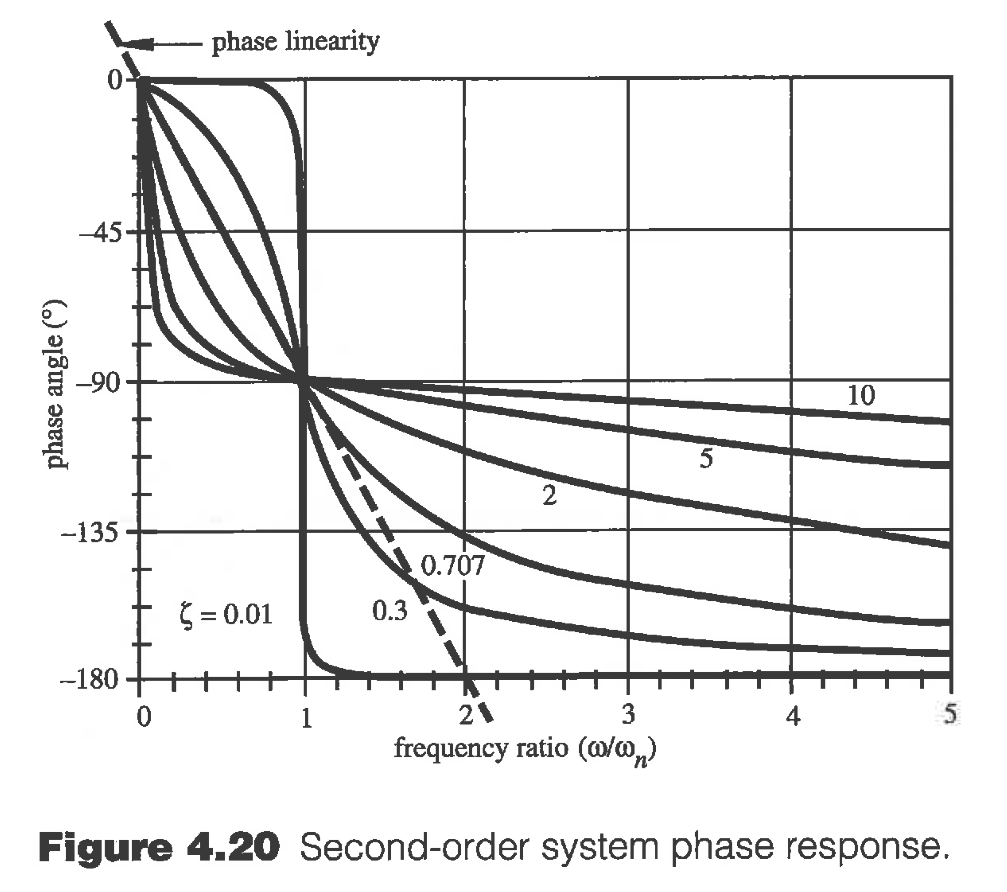
Frequency response of 2nd Order System
skipping the math again
Amplitude
Phase
Underdamped systems (ζ <<1) can destructively resonate around their natural frequencies. Identifying and eliminating resonances in machines such as helicopters and cars is very important.
Note ζ = 0.707 gives best approximation of phase linearity and the best amplitude linearity over the largest bandwidth. Amplitude linearity is important for passing information (signals)
Notes:
Demonstrate with a Pendulum.

Slide 15
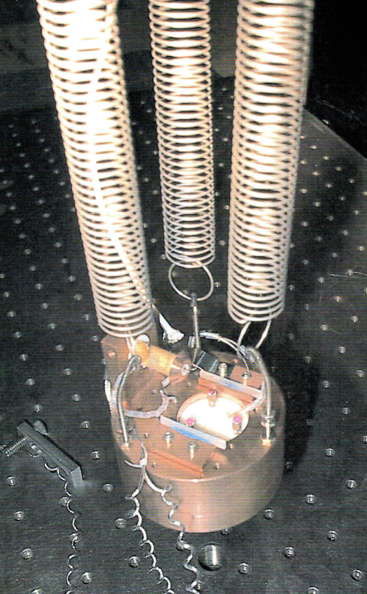
Example Questions
1. A scientific instrument needs to be isolated from external vibrations. The scientists have located the instrument in the basement of the building and have suspended the small measurement unit on a 500 g block of copper from three vertical springs. Each spring has a constant of 1 N/cm and is 20 cm long when hung.
a) Identify two resonant modes and give their frequencies. A third exists, but the resonant frequency is harder to calculate
b) For improved vibration isolation would you increase or decrease the resonant frequencies.
c) I helped build a scanning tunnelling microscope like this at the University of Alberta. Directly underneath the copper block we had an array of strong magnets. Why would we have done that?
Answers
a) If all three springs extend at the same time, then the block will vibrate up and down at a resonant frequency given by sqrt(k/m). k= 3 N/cm or 300 N/m. m=0.5 kg. w=sqrt(300/0.5) = 24.5 rad/s = 3.9 Hz
If the block swings like a pendulum without the springs changing in length, it will swing with an angular frequency of sqrt (g/L) = sqrt(9.8/0.2)=7 rad/s = 1.1 Hz.
Another mode of vibration is twisting, where the block spins about a vertical axis.
b) Everything vibrates. Every passing car, and person sends vibrations through buildings. We don’t want these to couple into the measurement device. Second order systems have a low amplitude response to frequencies above their natural frequencies (see previous slide). By lowering the natural frequencies you can block vibration across a larger range.
c) The magnets provide eddy current damping to the nearby copper block. This effect converts mechanical movement into heat and works well for good electrical conductors like copper.

Slide 16
When a cannon or gun fires, there is typically a recoil mechanism that loads the following bullet or round. If the mass of the moving mechanism is 3 kg and the effective damping due to lubricants is 25 Ns/m, what strength spring is required to give ideal damping?
Try this on your own first, then move away to see answer
Ideal damping occurs when the damping ratio is 0.7071 or 1/sqrt(2)
Or when b/(2sqrt(km)) = 0.7071
25/0.7071/2=sqrt(km)
312.5=km
k=104 N/m

Slide 17
Example from 2016 Final Exam
A 60 kg person stands on the end of a diving board and observes the board’s steady state position to be 0.3 m below horizontal.
a) What is the effective spring constant of this second-order system? (2 points)
b) What is the natural frequency for the system in rad/s? (1 point)
c) Write an expression for the damping coefficient (b) of the diving board in terms of the natural frequency (ω_{n}), the observed frequency of oscillation (ω_{d}), mass and spring constant. (2 points)
d) If there was a sinusoidal force applied with an amplitude of 30 kg (force) and a frequency of 0.1 rad/s, estimate the maximum displacement of the board? (Ignore the mass of the diver) (1 points)
e) If the frequency were increased to 50 rad/s, estimate the maximum displacement. (1 point)
f) Sketch the approximate amplitude response (gain versus frequency) for this system. Use a log-log plot. (3 points)

Slide 18
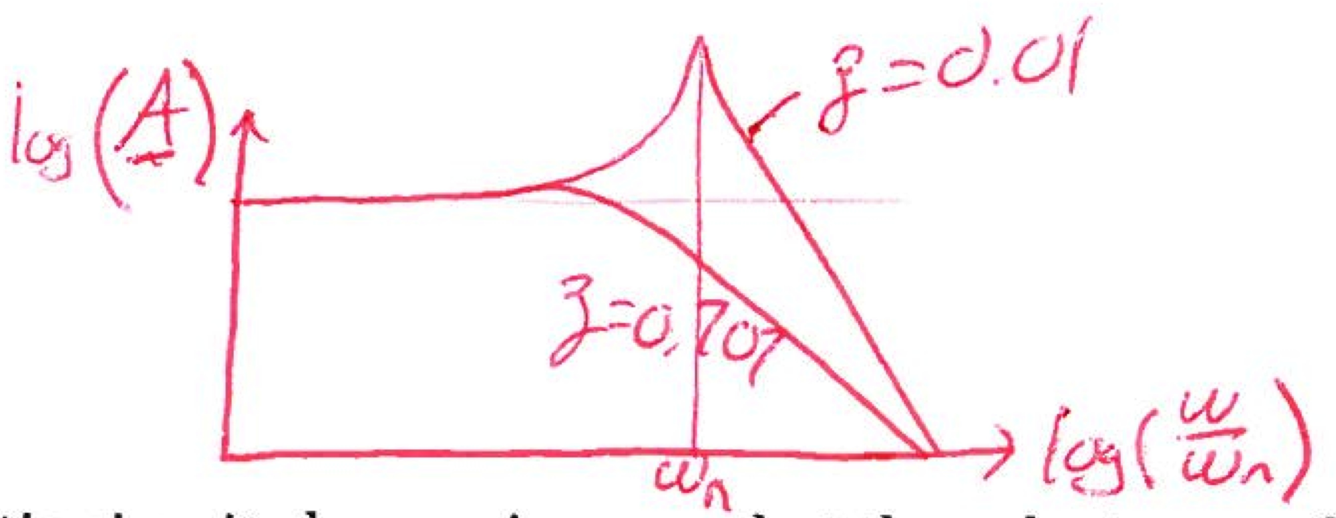

Answer
Try this on your own first, then move away to see answer
A: k=60*9.81/0.3 = 1962 N/m,
B: ω_{N}=sqrt(k/m) = sqrt(1962/60) = 5.7 rad/s, or 0.9 Hz
C:
$$ω_{d}=ω_{n}\sqrt{1−ζ^{2}}$$
$$ζ=\frac{b}{2\sqrt{km}}$$
therefore
$$b=\sqrt{1−{\left(\frac{ω_{d}}{ω_{n}}\right)}^{2}}2\sqrt{km}$$
D: since the frequency is much less than the natural frequency, the gain would be 1 and the amplitude would be 0.15 m (half that in a) so 0.45 is OK too
E: Since the frequency is much greater than the resonant frequency, the gain is nearly 0 and the amplitude is nearly 0.
F: only the underdamped curve, if log (gain) plotted the DC intercept =0. If gain is plotted then DC intercept = 1.

Slide 19
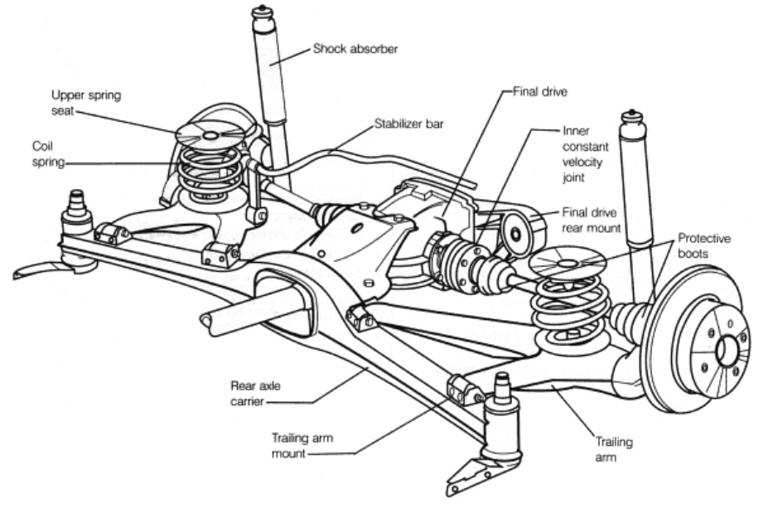
Many automotive suspensions use a vertically mounted spring and damper. If the total vehicle weight is 600 kg equally distributed, and the springs have a constant of 35 kN/m.
What damping constant is required for a damping ratio of 0.8?
What is the resonant frequency of the vehicle?
If the vehicle flipped over onto its roof, would the wheels be under or over damped?
Sketch the step response and bode plots for an underdamped, overdamped and ideally damped 2nd order system. Make two plots in total, with 3 curves on each.

Slide 20
Answer
a) 600 kg equally distributed means 150 kg per shock absorber. k= 35000 N/m
0.8 = b/2/sqrt(km)
b=0.8*2*sqrt(150*35000) = 1.16 kNs/m
b) Resonant or natural frequency = sqrt(k/m) = 15.3 rad/s = 2.43 Hz
c) If the vehicle were upside down, the suspension now controls the movement of wheels, which have a much lower mass. Therefore the damping ratio increases and the system is overdamped.
d) See figure 4.16 for step response and figure 4.19 for bode plots
Try this on your own first, then move away to see answer

